Slide 1
AI for Kids
UK Robotics Week 2024

Slide 2
This Story is about the story is about UK robotics week and children need to experiment with generative AI and
This story is created by:
John
Manal
Mary

Slide 3
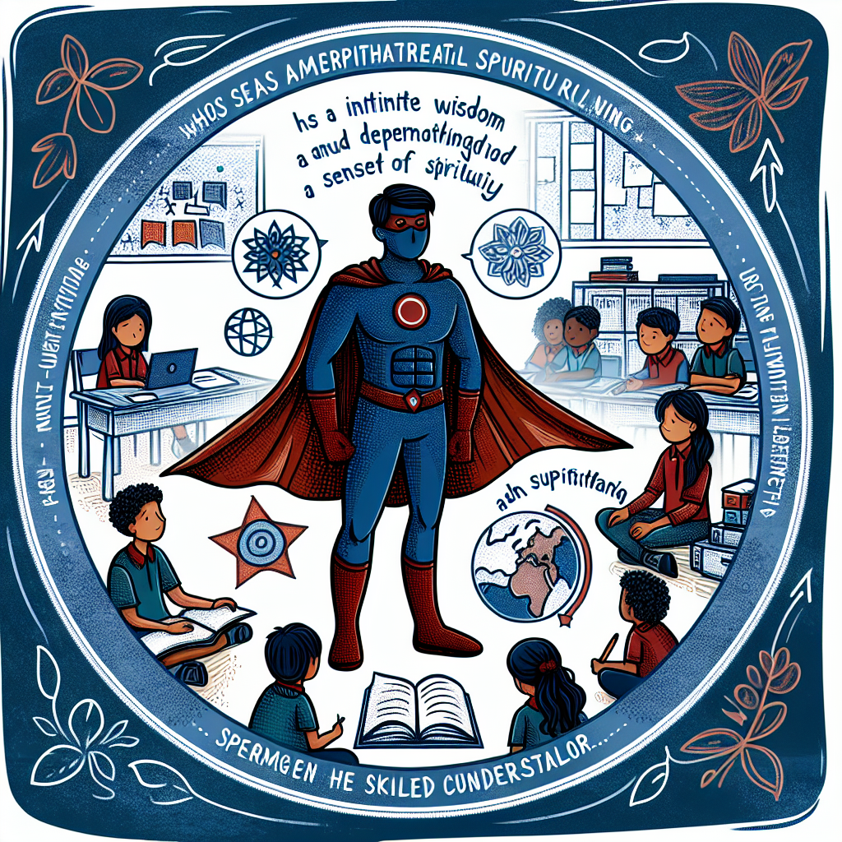
How about a superhero who uses the power of empathy and kindness to help others? They could guide their friends
through challenges and offer wise advice when needed. This superhero could teach valuable lessons about understanding and supporting one another.
Create an illustration of a superhero child, around primary school age. This unique superhero has an innate wisdom and sense of spirituality, often serving as a guiding figure for others. In addition, their empathetic nature and deep understanding make them a skilled counsellor. They can be seen in their superhero outfit, completed with a symbol that reflects spirituality and support. As a backdrop, depict a primary school setting with classrooms and students. This diversity of students express their admiration for this superhero child who strives to bring peace and harmony in their environment.

Slide 4
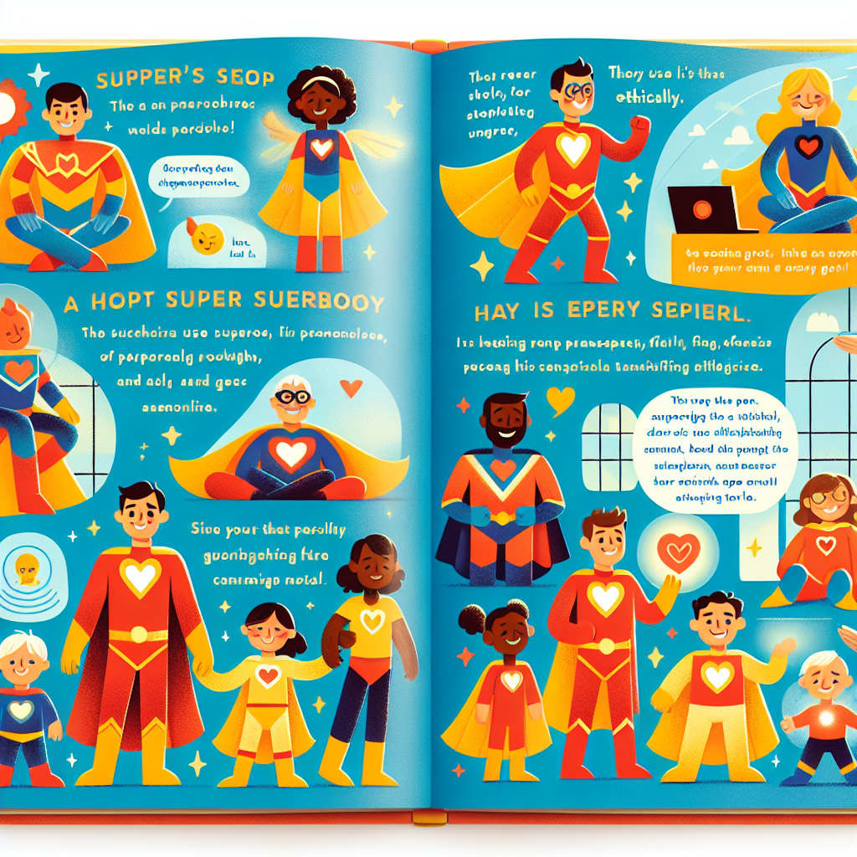
How about creating a superhero who uses their AI abilities to guide others towards personal growth and provide emotional support, all while upholding ethical
standards? This character can serve as a spiritual leader and counselor, offering a unique blend of technological and emotional assistance to those in need.
Illustrate a page of a children's storybook. It portrays an array of superheroes, each distinct in their attire and superpowers. They are helping people of different descents, genders, and ages, fostering their personal growth and providing emotional support. These superheroes utilize an interesting tool: artificial intelligence. They use this technology ethically, showcasing transparency, fairness, and effectiveness in their actions. The illustration has a warm, uplifting vibe, emphasizing the positive impact of superheroes using advanced tech for good. Remember to keep it colorful, bright and cheery, suitable for a kid's storybook.

Slide 5
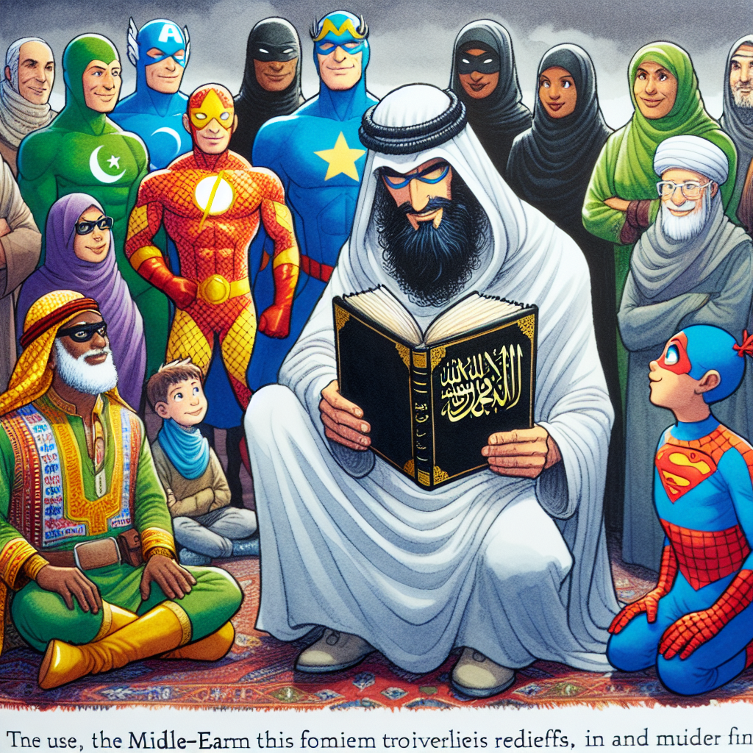
Introducing "The Empathy Enchanter," a superhero who uses AI to provide spiritual guidance and emotional support tailored to each
individual's beliefs and needs. Children can learn the importance of empathy and understanding different faiths in a compassionate way.
An illustrative scene from a children's storybook, where superheroes are engaged in offering personalised spiritual advice. One of the superheroes, cloaked in flowing robes, holds an Islamic book in his hand, symbolising the Muslim beliefs and needs. The superhero is explaining from the book, demonstrating openness and respect to diverse religious faiths. He is Middle-Eastern in descent, but the image also shows a diverse range of other superheroes listening attentively, capturing a broad spectrum of gender and ethnicity. The scene evokes peace, understanding, and mutual respect.

Slide 6
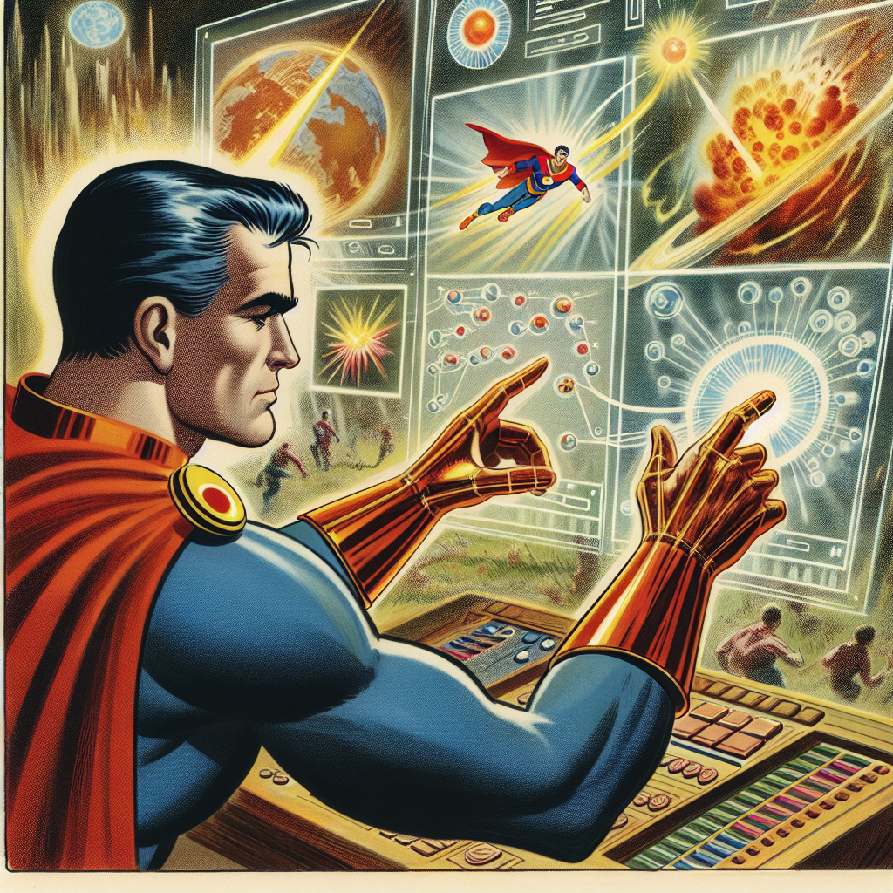
The superhero could use virtual reality simulations to help
students understand complex concepts in science through hands-on experiences.
An image depicting a storybook scene, where a superhero is engaged in conceptualizing and creating virtual simulations. The superhero, a Caucasian male with broad shoulders and dressed in a vibrant costume, is seen immersed in a hi-tech virtual environment which is projected from his futuristic gadget. His fingers, quick and nimble, navigate through hovering 3D models of different scientific experiments. These may include a model of the solar system, an erupting volcano, or even minute particles representing a chemical reaction. On a translucent, projected screen nearby, different hypotheses are seen, waiting to be tested within these simulations before being implemented in real life.

Slide 7
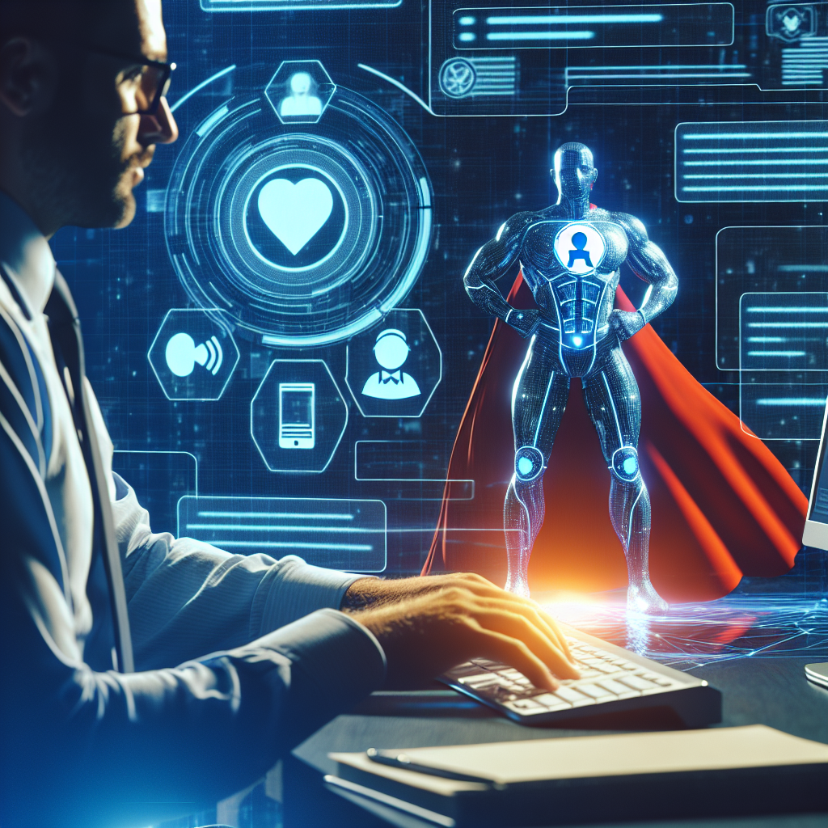
The superhero could use AI to simulate scenarios to give practical advice to users before they try it in real life. For example, if someone is struggling with a difficult decision, the superhero can create a simulation to help them see the
potential outcomes of each choice. Furthermore, the superhero could provide 24/7 virtual counseling and support through AI-powered chatbots. For instance, if someone asks for advice on managing stress, the superhero can send them relaxation techniques and motivational messages to help them cope.
Create an image of a fictional technology-savvy superhero, characterized by a bright costume and emblematic emblem. With the power of artificial intelligence, this hero provides around-the-clock virtual counselling and support to those in need through AI-powered chatbots. The scene captures a moment where an individual is interacting with the superhero via a virtual communication device. The individual is seen typing out a question seeking guidance, to which the superhero immediately responds through an engaging and empathetic AI chatbot conversation.

Slide 8
Thank you for your Participation Today
We hope you enjoyed this experience and find it useful

